Slide 1
Leveraging Your Team to Attract, Engage and Retain Customers
Dulles SHRM
March 18, 2015
Notes:
Question We Answer:
How can I accelerate results by truly engaging my team in the growth of the company?
Our Specialty?
Working with highly educated, smart teams who:
are client facing
understand the clients’ needs
have the potential (with some new skills and abilities) to collectively impact top-line revenue with successful business development approaches

Slide 2
It’s All in the Delivery
Employees at every level can make or break the client relationship
Similarly, they can identify or miss referrals, new opportunities and requests for new service offerings
Exec.
Staff
Client touch points
Management
Individual Contributors
Notes:
Our clients realize it’s all in the delivery. Ever had great client rel’n, everything is going well, and one individual does something you really wish they had not?
Huge impact on clients

Slide 3
Highest and Best Use of Our Time
Customer Loyalty
“Why”
Customer Experience
“How”
Wants/Needs
“What”
$
Goal!
Notes:
Goal: two or three practical tactical ideas
As advertised – Leveraging your Team to Attract, Engage and Retain customers – makes sense – natural customer lifecycle
To work on this issue – have to go backwards. Hence – upside down pyramid –
Really have to have a culture focused on not only retention but loyalty – discuss in a minute. Having people understand the “why” here is huge. (May seem obvious to you)
After retention – we have to work on “how” do we keep customers and turn them into raving fans – Customer Experience. Understanding how small internal innovations can translate into significant loyalty results.
Once we start truly focusing on Customer Experience- the question becomes “what” do we need to change in order to understand customers wants and needs. “ AND to discover what else they might need, what else they think we should be providing AND who else they might know who has some needs.

Slide 4
“Why” Customer Loyalty:
A Strategic Choice?
“Each day be grateful for three things: past clients, current clients and future clients.” -Shama Hyder
Notes:
Want to review some numbers, talk to you about whether you think having what we call a maniacal focus on customer experience and customer loyalty is a strategic choice, or an imperative?
Need us on the same page – also a conversation you can have with your teams
Happy to share these slides – just give me or Renee your card later

Slide 5
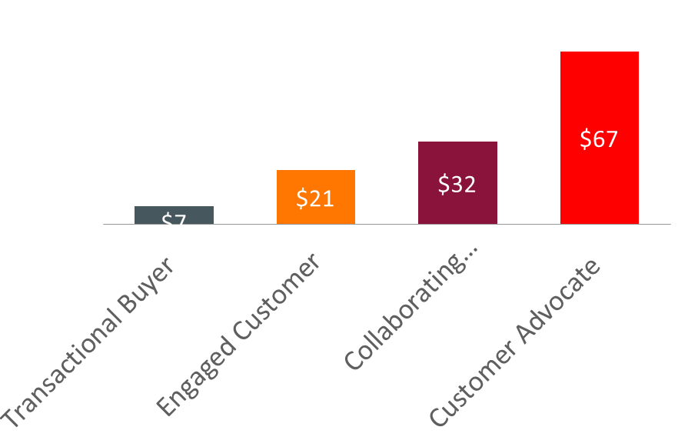
Customer Engagement - Oracle
Increased Engagement = Higher Spend
Relentless Focus on:
* All Values shown are averages in $M USD
Customer Feedback
Ease of Doing Business
R&D Strategy
Customer Engagement
Employee Engagement
Communities
References & Loyalty
Notes:
Intuitively understand how important CL is – pretty familiar with some basics over the cost of customer acquisition – right? How much more expensive it is to bring a new client on board versus keeping the one you have? Anyone willing to share numbers on that – what they have heard or what they are experiencing?
Jeb Dasteel – Oracle’s Senior VP and Chief Customer Officer – presenting at a conference in Atlanta last spring – CXPA
Shared fascinating analysis on how a strategic focus on Customer Loyalty – which they break down into categories – knowing exactly where you were in the quality of the customer relationships led to significantly higher customer spend – 9 times higher to be precise

Slide 6
Lessons from Oracle
1
2
Establish a simple, clear segmentation strategy
3
Be crystal-clear about what drives your customers’ loyalty
4
Identify the leading indicators
5
Start with feedback and analytics
Connect the dots – between feedback, customer care, referencing
6
Systematically move from reactive
to proactive behaviors
7
Don’t try to change the culture –
exploit it
8
Manage executive engagement
9
Make it your mission to
really know
your top customers
10
Engage
directly with customers
6
Notes:
Few here that I think are worth highlighting –
What drives loyalty
Moving from reactive to proactive
Know your top customers
Engage directly with customers

Slide 7
Customer Loyalty – Engine of Growth
Raising customer retention rates by 5% can increase profits by 25% to 100%
(Reichheld – The Loyalty Effect)
A 5% improvement in customer loyalty can translate into a doubling of margins
Loyal customers always return and become a lifetime sales stream
“Customer Satisfaction is…
a Strategy for Going Out of Business”
(Renee and Lesley – feel free to quote us!)
Notes:
Pertinent facts:
5X more expensive to acquire a new client.
7 touches from cold call to sale.
Is satisfying your customers good enough?
So if satisfaction is not enough – what does loyal really mean?

Slide 8
Satisfied or Loyal?
Customer Loyalty
The willingness of a client or customer to refer an organization’s product or service offering to someone they trust.
Notes:
What is the difference between satisfied and loyal?
Think of your own personal experience – how hard is it to refer? Ever had it bite you?
Do exercise in handout – something you can do with your team – getting them to understand the “why” it matters requires some discussion with them

Slide 9
Loyalty: Cause-and-Effect
“There is a critical cause-and-effect relationship between Customer Loyalty and Employee Loyalty. It’s impossible to attain a loyal Customer base without a loyal employee base.”
                John Avella, Columbia University
Notes:
Last note on loyalty - Studies prove what we would intuitively believe – cannot build customer loyalty without internal loyalty.
I think you get that – otherwise you would not be here. It is worth, however, sharing this sentiment with your team.

Slide 10
Seeing Their Impact – 3 Phases
Shifting Perspective
Examining what they do from the perspective of the customer
“Quality in a service or product is not what you put into it. It is what the client or customer gets out of it.”
Reflection vs Reaction
Carving out the time to THINK about how to increase value for customers
Getting beyond solely reacting to the “issue of the hour”
Realization and ACTION
Pushing through to action – what they can and will DO with ideas to strengthen customer relationships
Understanding many small actions add up to BIG results
Peter Drucker
Notes:
I’m sharing ideas for you to help them shift perspective. We do a lot of work with teams when senior leadership decides to carve out the time for reflection vs reaction. That takes time.
Third phase – realization into action – similarly needs an internal “drip” marketing campaign – even once they shift perspective, they reflect on their contribution and impact and they realize the potential – they still often need support in learning how to translate that into action.

Slide 11
“How” – Customer Experience
“I realized that I have to look at the big picture and that I am just one small piece of the big picture. I need to make sure that I give 110% of my piece and everyone else around me does as well.”
Notes:
So customer loyalty is the desired outcome – that’s the lag indicator – are they still with you, are they still buying, how much did they buy, did they refer you to others.
Customer experience is about leading indicators. What is happening every day between your company and your customers that is either driving or detracting from customer loyalty?
Note participant quote – this is the goal – engaging employees to choose to give 110%

Slide 12
Creating the Seamless Customer Experience

Slide 13
Becoming “Indispensable”
Peak: How Great Companies Get Their Mojo from Maslow (Chip Conley, 2007)
Notes:
So how do we become “indispensable”. How do we manage engagements/relationships in such a way, that we create raving fans?
When I talk with groups about Customer Experience, and I ask for an example in their personal lives of some example of where CX has been good – they tell me about Chick Filet or Marriott. When I ask them about bad – they talk about cable or telecommunications providers.
Same conference last spring – heard Bob Johnson – President of Sprint retail talking about their shift in focus over the last few years and the realization that customer experience was going to make or break them. They now have a motto of “serve, solve, satisfy”. Intense focus on first call resolutions as opposed to “hold while I transfer you to my colleague” – saved roughly $1B in call center expenses (74 centers have become 40 since 2009). NOT EASY. Not an “initiative” – core to their very being.
Enormous financial return, BEFORE you even take into account the reduced “churn” of customers and the potential for loyalty they are creating.
If time – share story about hand written notes to customers from team members. Thank you for being our customer. Small steps – huge impacts.

Slide 14
Employee Impact
Three keys to loyalty:
  Trust
  Emotional Connection
  Empathy
“Relationships of trust depend on our willingness to look not only to our own interests, but also the interests of others.”
          Peter Farquharson
Notes:
\
Discuss three keys to loyalty – trust based on your performance. What else?
Did you know people actually buy (and keep buying) based on emotion?
Empathy = understanding, and we buy from people who we believe “get us”
So the loyalty definition refers to trust - let’s look at trust.
This quote from the head of Habitat for Humanity in Northern Ireland.
Looks obvious, but the complex can appear to have an elegant simplicity.
Farquharson’s message - looking at the interests of others so their success drives our collective success.

Slide 15
Customer Relationship Assessment
 | Always | Some- times | Rarely | Never
I realize how important it is to establish trust with the Customer.
2. I try to put the Customer’s agenda ahead of mine.
3. I take pride in my work.
4. I understand my Customer’s needs and actively seek ways to improve how we interact with the customer to meet those needs.
5. I am knowledgeable and honest about our products and service.
6. I only promise what we can deliver.
7. I don’t put off dealing with an upset Customer.
8. I take responsibility for errors we make as a company and attempt to resolve the Customer issue (whether it was my fault or not)
9. I listen carefully to the Customer and as questions to find out how we are performing and how they feel about our products/services.
Notes:
that focuses on client relationships – take 5 minutes to complete. (Again something you can use with your teams – happy to send you pdf. Seen some fascinating conversations amongst teams about where they are on this scale and why.)
Findings? Again – what one thing could you do differently next week to accelerate results for 2014-15?

Slide 16
Team Discussion Questions
Our customers regularly ask us to do more than was originally requested – to create and deliver more value building upon our existing engagement/contract.
□ Yes □ No
We regularly receive referrals from existing customers to new prospects.
□ Yes □ No
Our customers fully understand the value we bring on a daily/weekly basis.
□ Yes □ No
(How do you know?)
Our customers view us as indispensable, rendering it very difficult for our competitors vying for our business.
□ Yes □ No
(How do you know?)
Notes:
This can strengthen the “why” does it matter (already discussed) – but also find this set of questions prompts a powerful dialog about how we are doing as a group and begins to crack that code of “what role do I play in all of this”. It also follows well from last assessment – if we are doing so well on all of these things, and we have strong relationships (according to us) – where are the referrals? Where is the new business
Example – huge question number 3. Let’s do this one as a group, and you will see how you can do this with your team. (in handout)
Debrief – too busy being good to ensure they understand the full value. Managers also often don’t know that the team members is doing some of the things they are doing – has prompted discussions around the need for innovation, scope creep, and most importantly a discussion around how to subtley ensure the customer really understands how you are on their team.

Slide 17
“What”: Understanding True Wants and Needs
“God gave us two ears and one mouth, and they should be used in that proportion.” - Unknown
Notes:
So we have everyone understanding “why” loyalty matters – engine of growth – can mean promotions, raises, new opportunities etc. We’ve discussed a few ideas to get them seeing “how” to turn customers into raving fans – and how small innovations on their part can make a huge difference.
Now – what do we need to change/shift to ensure we truly understand what our clients want and need

Slide 18

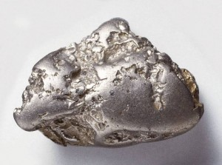
Shifting Perspective
Golden Rule
  Do unto others as you would have them do unto you
Platinum Rule
  Do unto others as they would like done unto them
Notes:
Really all about putting yourself in your customers shoes

Slide 19
Power Questions for Service Providers
“How are we doing in terms of meeting your needs?”
  “Fine” is not a good answer! Mine for challenges and successes
“What is your largest concern at this point” (in the project, in terms of what we are discussing)?
  Remember 3 key components for developing loyalty – trust, emotional tie, empathy
“Is there anything else?”
Notes:
Platinum rule impossible, if you don’t know what the client truly needs and wants.
Questions you can ask:
- discuss power of 3 – ask three times, you will get feedback
- make life simpler – who doesn’t want that?
Note: “Is there anything else” is a great question to ask your client. (Cite Ventera outcomes – huge pending “on the tip of their tongue” comment and request – if I knew you were really good at xyz, I would invite you to bid on this upcoming project…

Slide 20
More Power Questions
“If I could change one thing about what we are doing that would really help you, what would that be?”
“What do I need to know that we have not discussed?”
What other questions would you add?
Notes:
Note: G&B solutions – account managers that are experts in their field. Resisted asking questions because it makes them look un-knowledgeable. Worked with them on questions specific to their client engagements, good questions (not stupid), set assignment to try these over the week and come back and report. Results – one client at risk, other one sitting with huge opportunity they did not know about.

Slide 21
Asking for Referrals
When?
  End of great assignment – real results
  Following testimonial
How?
  In person or on the phone
What do you ask for?
    Specific request (enlightened leaders, 100+ employees, 25M+ revenue)
Notes:
So with trust you get loyalty – with loyalty you should get referrals and the engine of growth hums along. How do you all do with referrals? Get as many as you possibly could?
When do we ask?
If you don’t, when should you ask?
In person, end of great assignment, after a testimonial (which you can write for them)
How do you ask?
Discuss client that was peppering customers with paper surveys and then asking for referrals.
What Do you ask for?
- What is different now that you have specific strategic planning goals? (enlightened leaders, minimum revenue $25M, 100 employees)
- Discuss what happens when you don’t make a specific request (I have a completely messed up company you could help)
Bottom line – suggest need a strategy on this. Not a simple thing to make “habit”. How you leverage existing rel’n, how you coordinate the “ask” – takes some effort (more than we can address in one simple session)

Slide 22
Understanding Wants & Needs = SALES
“All of us are involved in selling every day. Whenever we present a product or principle, inform a client, or instruct a child, we are engaging in the art of effective persuasion.”
Zig Ziglar
Notes:
Power questions – you can work with your team on that. Referrals – you can work with your team on that. Last area I will probe is the reaction in your organization to the word “sales”
Some call it BD, others call it mktg, other call it “strategic relationships”
It’s an attitude and we’ve been thoroughly trained to think “yuch”. Not limited to this room – Fortune 500 client – insurance carrier. Outstanding people, smart, energetic and until about two years ago though sales was a dirty word.
Happy to say our work with them has converted this resistance into an understanding that meeting client needs and providing value they would not get from other vendors is a noble calling, and sales are, in fact, rocketing.
This one takes a little time and effort – so I’m not going to suggest you can simply have this conversation with your team and they’ll shift their opinion. But it is a starting point of some powerful conversations.

Slide 23
All Hands Approach to BD
“… the job of selling doesn’t have to conflict with our personal values. I have always thought of the business development and sales aspect of this work as being either hat-in-hand humbly asking for work from people we know, or a bit of sleazy manipulation.
But you have helped me realize how just improving … the relationship, listening and how to apply [key] skills can allow me to be successful … to meet clients’ needs in a much more positive way.” [IT Program Manager]
Notes:
Not a very far shift from discussing CL and CX to really talking about sales with non sales people. Just to give you a sense of what happens when we do that..
This was a program we designed for a very large gov’t contracting firm
Debated including this – really just wanted to say if an IT Program Manager can shift from sales is sleazy to I’m meeting clients needs in a positive way – then it should be possible for everyone in this room to (hopefully) take-away some of these ideas and apply them directly in your business.

Slide 24
One Simple Change
Based on discussion, what one action can you commit to over the next week to:
  Seek a referral (testimonial)
  Learn more about client’s real needs
  Ask “power questions” to validate what you think you already know
  Implement something else that came to mind during our discussion?
Notes:
This is a slide we use with teams and I would suggest you can do the same. If you have had the conversation about loyalty (why) and you’ve talked about the Customer Experience (how to make them raving fans) and some general ideas have come up around the “what” they could each do differently – NOW is the time to ask – what can you do differently over the next week.

Slide 25
Thank You
Questions?
Lesley Boucher
lesley.boucher@pensaregroup.com
240 381 7287

